Slide 1
Augmented Reality for Remote Laboratory Improving Educational Learning: Using PSO in Object Tracking Scheme
Presented by
Seid Miad Zandavi, Vera Chung
School of Information Technologies

Slide 2
Outline
Motivation and Background
Contributions
Experiment design
Results
Conclusion

Slide 3
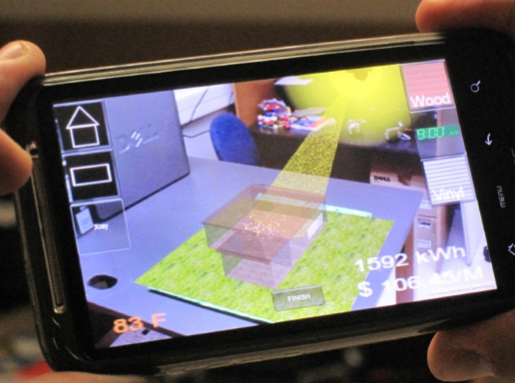
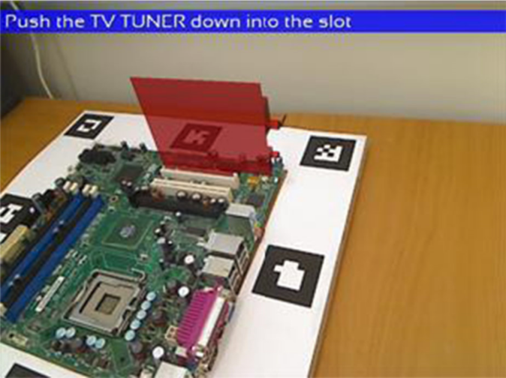
Motivation and Background
Augmented reality (AR) is a technology to augment informative information into real world as augmented component merged in the same position of real objects.
AR is the real opportunity for enhancing learning
Video tracking is important to add information because of knowing positions.
Observation Model
Motion Model
Swarm Intelligence algorithms

Slide 4
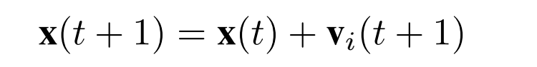
Particle Swarm Optimization (PSO)
A group of birds are randomly seeking food in a specific area.
The birds know their distance in any moment.
The fitness value directly affects the direction and speed of bird movement toward the optimal solution.

Slide 5
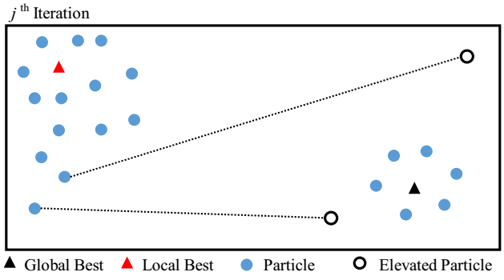
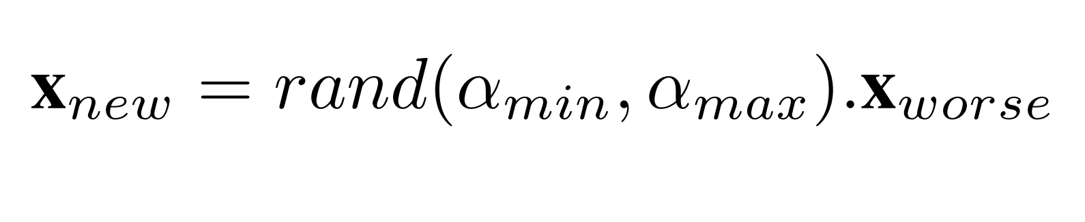
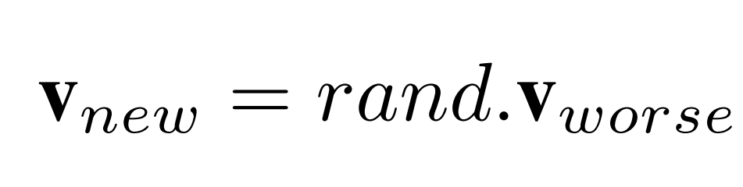
Elevated PSO in Object Tracking
25 Percent of the worst particles are randomly elevated to other area of search space.

Slide 6
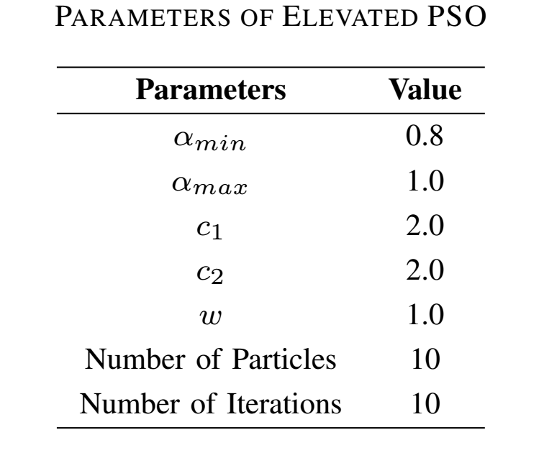
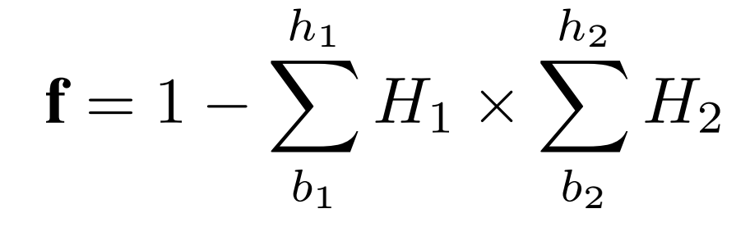
Tuned Parameters of Elevated PSO
A self-made video, a pendulum in remote labs at the University of Sydney, is selected to demonstrate the performance of Elevated PSO in real application.
Cost Function

Slide 7
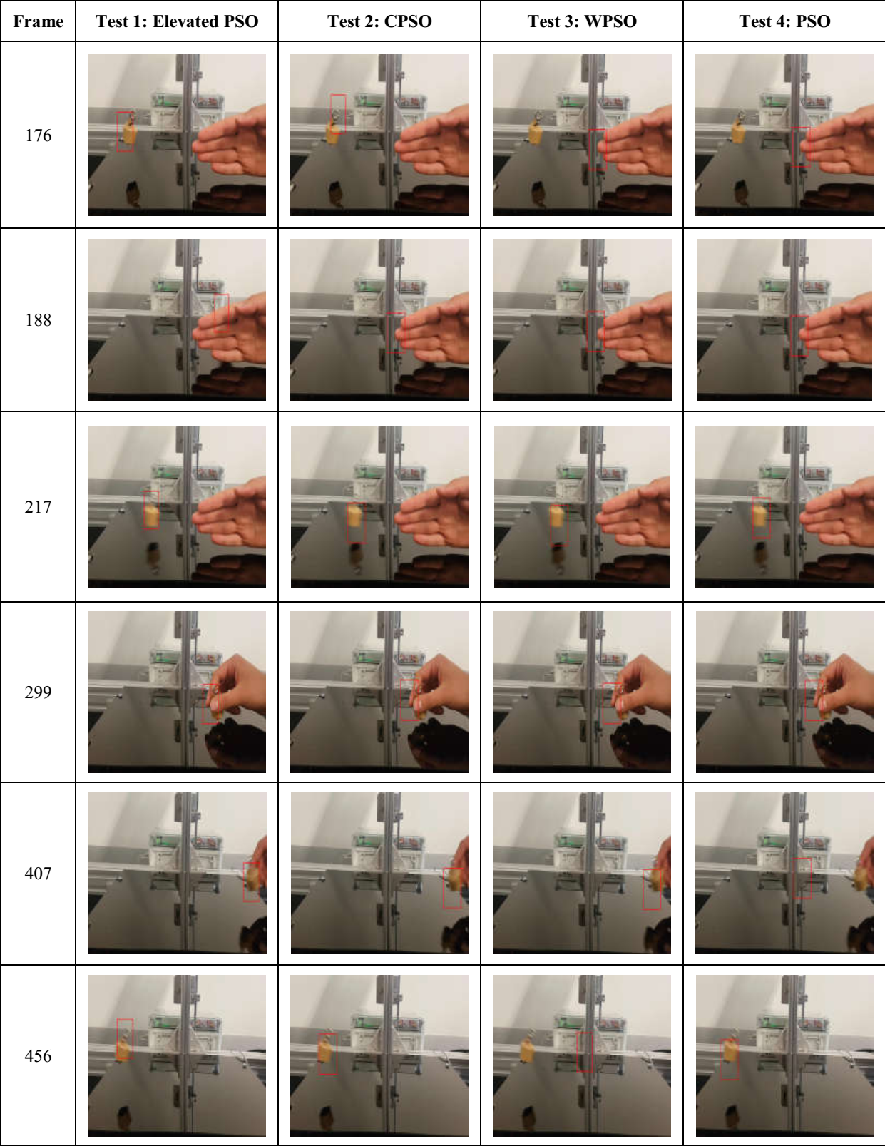
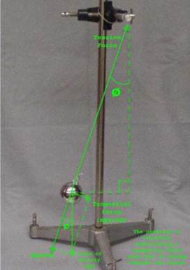
Results

Slide 8
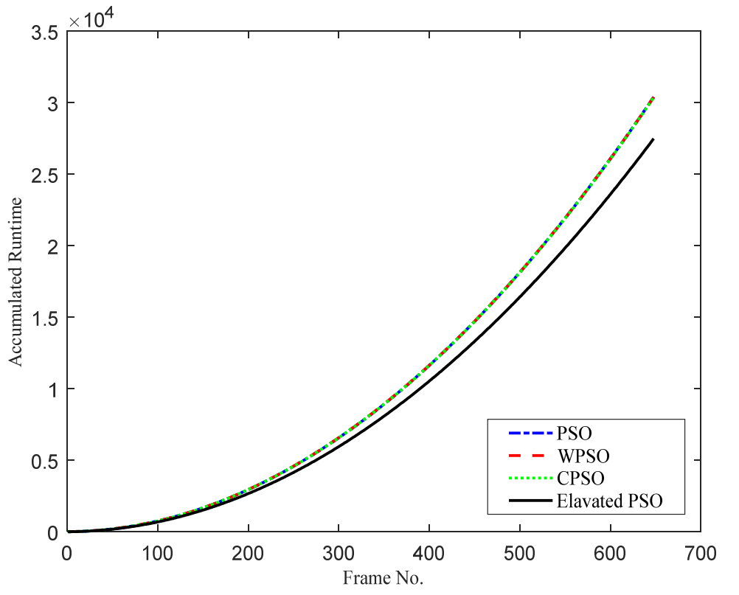
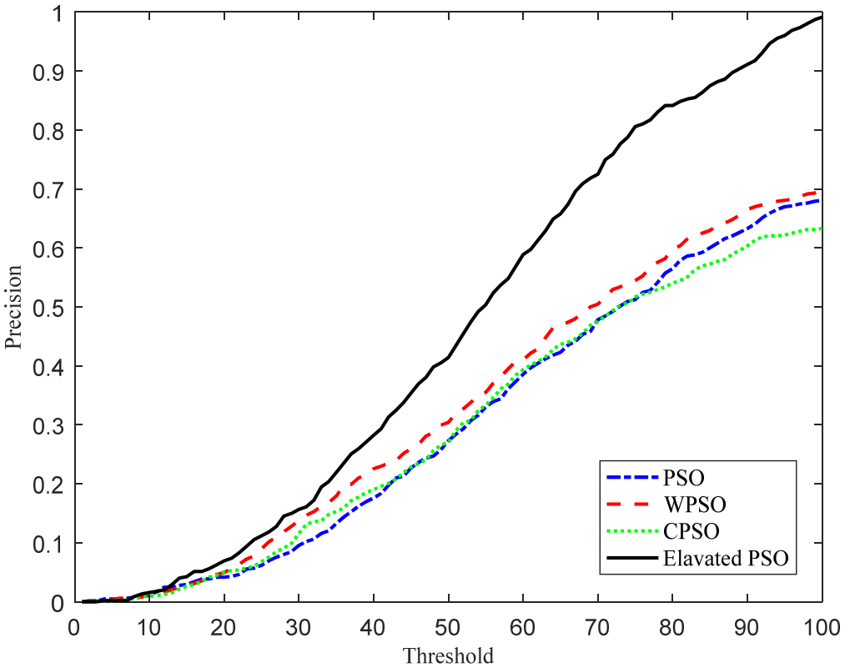
Results

Slide 9
Conclusions
Augmented Reality (AR) was investigated as unique technology to combine virtual and real world together
Remote Laboratory is a great application for AR learning.
Object tracking problems is used to make visible invisible issue.
Elevated PSO was proposed to track object in the scheme of remote labs.
The proposed algorithm has a competitive result in comparison with other improved PSO.

Slide 10
Questions?

